Slide 1
Abstracting spreadsheet data flow through hypergraph redrawing
David Birch¹, Nicolai Stawinoga¹, Jack Binks², Bruno Nicoletti², Paul Kelly¹
¹Imperial College London
² Filigree Technologies, London
InnovateUK
Grant 104141

Slide 2
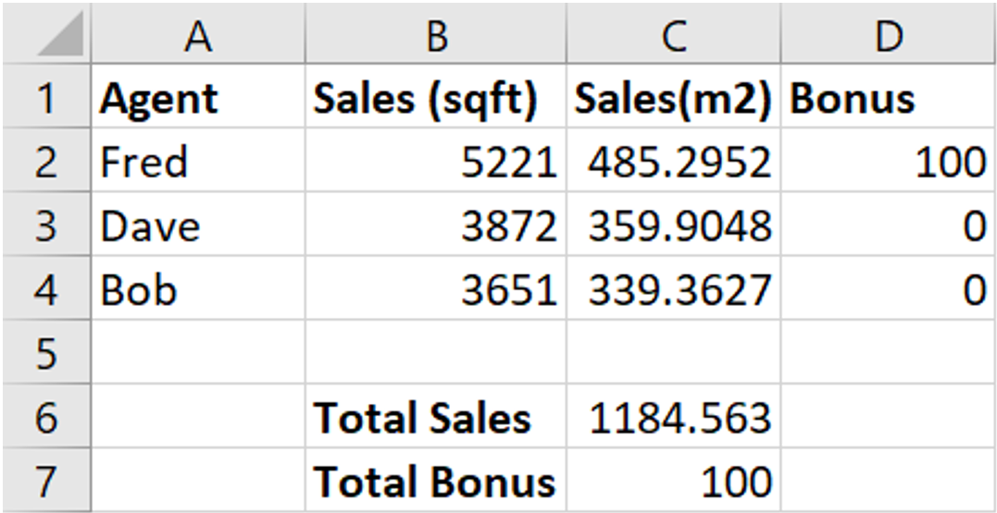
What do you see?
Words?
Numbers?
Maths?
A table?
A grid?

Slide 3
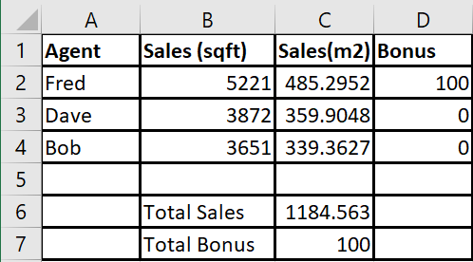
How about a prison?

Slide 4
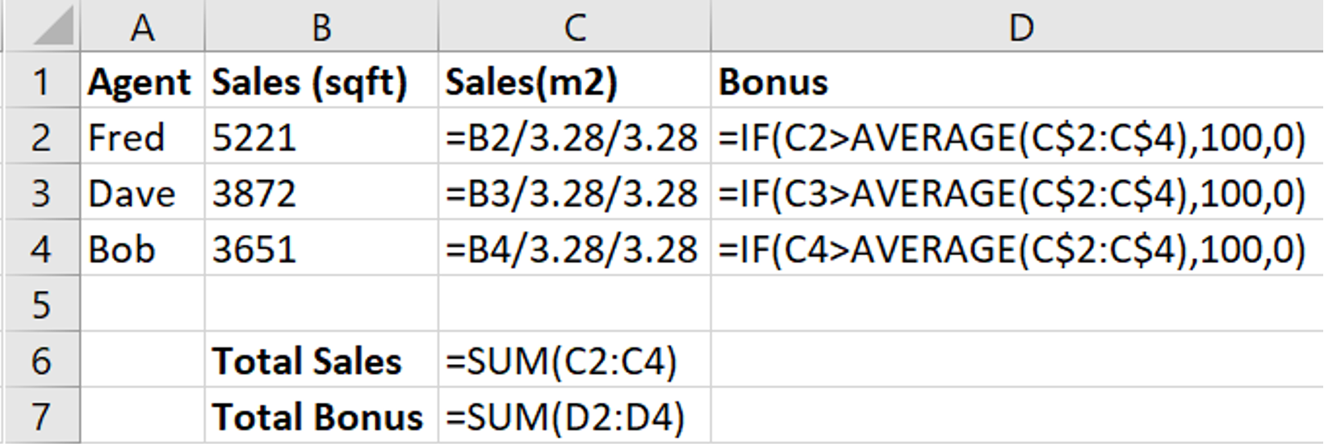
Many friendly numbers and mathematical things are imprisoned :*(
“Cells”

Slide 5
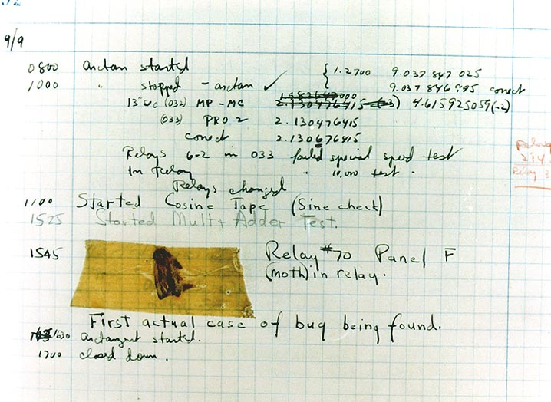
We know there are other things hiding inside this prison
The First "Computer Bug" Moth found trapped between points at Relay # 70, Panel F, of the Mark II Aiken Relay Calculator while it was being tested at Harvard University, 9 September 1947 (public domain)

Slide 6
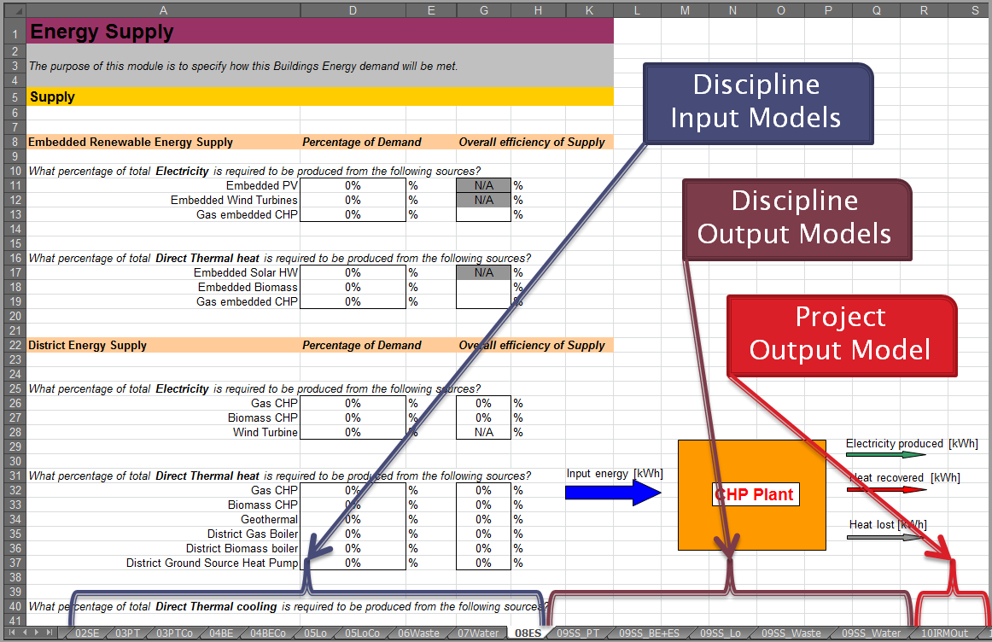
So how do we know what this prison does?
Abstraction Required
Page J., Grange N. and Kirkpatrick N. The integrated resource management (IRM) model - guidance tool for sustainable urban design. In 25th Conference on Passive and Low Energy Architecture, PLEA08, October 2008

Slide 7
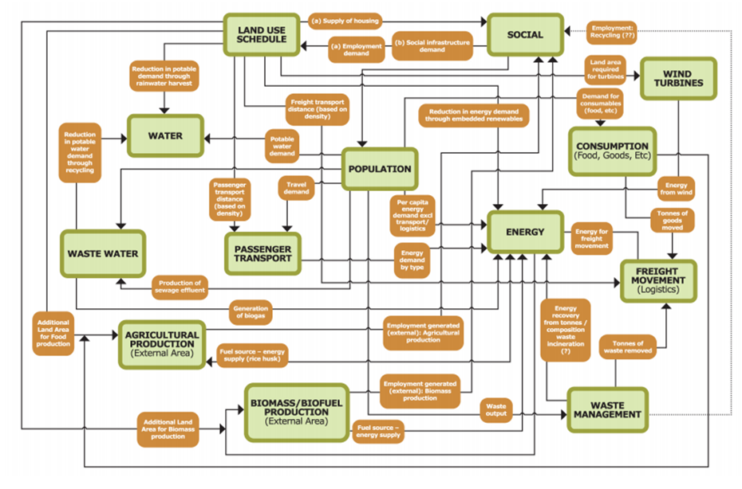
Maybe we have a diagram or mental model?
Abstraction Required
Page J., Grange N. and Kirkpatrick N. The integrated resource management (IRM) model - guidance tool for sustainable urban design. In 25th Conference on Passive and Low Energy Architecture, PLEA08, October 2008
Notes:
Complexity of the model
Each discipline has its own model

Slide 8
Scientific Model Making
Scientific Model
Real World
Conceptual Model
Mathematical Description
Code
http://www.easterbrook.ca/steve/?p=2030
Notes:
Validation = are we building the right model?
Verification = are we building the model right?
I think the reason why there is no other description of the model except in Excel is that because parts of the conceptual model are held in people’s heads – dozens of people on a project. I don’t think anyone has ever tried to document it (which is why people are sceptical that you can formalise an intuitive process like spatial design).

Slide 9
Verification / Validation
Scientific Model
Real World
Conceptual Model
Mathematical Description
Code
Validation
Verification
http://www.easterbrook.ca/steve/?p=2030
Notes:
Validation = are we building the right model?
Verification = are we building the model right?
I think the reason why there is no other description of the model except in Excel is that because parts of the conceptual model are held in people’s heads – dozens of people on a project. I don’t think anyone has ever tried to document it (which is why people are sceptical that you can formalise an intuitive process like spatial design).

Slide 10
Spreadsheets
Scientific Model
Excel Models
Real World
Conceptual Model
Mathematical Description
Code
Real World
Conceptual Model
Excel Formulas
Notes:
Validation = are we building the right model?
Verification = are we building the model right?
I think the reason why there is no other description of the model except in Excel is that because parts of the conceptual model are held in people’s heads – dozens of people on a project

Slide 11
Spreadsheets
Scientific Model
Complex Excel Model
Abstraction Required
Real World
Conceptual Model
Mathematical Description
Code
Real World
Excel Model Formulas
The excel model has become the conceptual model
Notes:
The excel model has become the conceptual model

Slide 12
Agenda…
Just what is a “Cell”?
How we can abstract “Cells” by redrawing their cells walls?
Our friends at Filigree Technologies are going to talk to you about a new playground for them

Slide 13
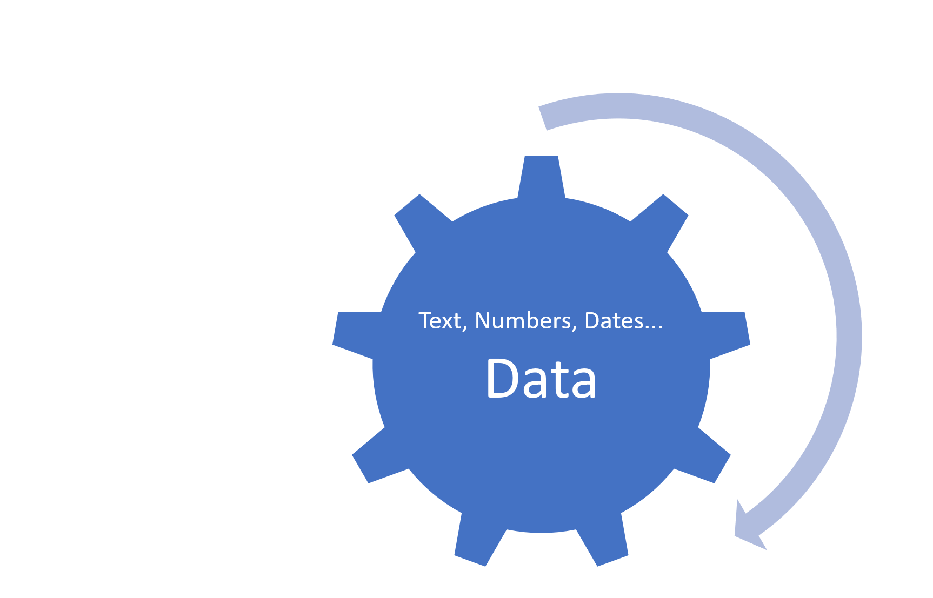
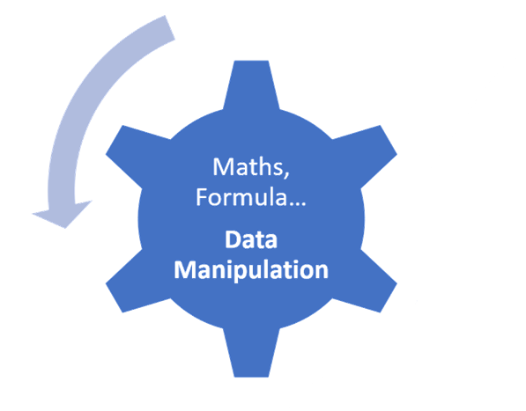
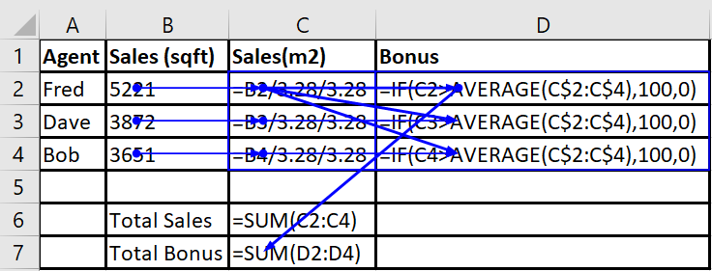
What are these things?
They have position:
Row
Column
Worksheet
…
Relative
They have relationships:

Slide 14
What are these things?
Text, Numbers, Dates...
Data
Maths, Formula…
Data Manipulation

Slide 15
a data container or data manipulator linked by user-intent to model their world and positioned to reflect its structure
So just what is a cell?

Slide 16
Let’s organise a jail break
Notes:
https://csacademy.com/app/graph_editor/
B2
B3
B4
C2
C3
C4
D2
D3
D4
C6
C7
C2 B2
C3 B3
C4 B4
D2 C4
D3 C4
D4 C4
D2 C2
D3 C2
D4 C2
D2 C3
D3 C3
D4 C3
C7 D2
C7 D3
C7 D4
C6 C2
C6 C3
C6 C4

Slide 17
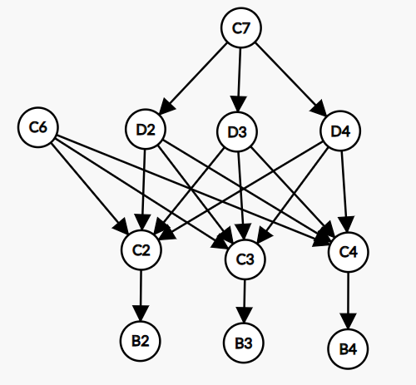
Let’s organise a jail break
Notes:
https://csacademy.com/app/graph_editor/
B2
B3
B4
C2
C3
C4
D2
D3
D4
C6
C7
C2 B2
C3 B3
C4 B4
D2 C4
D3 C4
D4 C4
D2 C2
D3 C2
D4 C2
D2 C3
D3 C3
D4 C3
C7 D2
C7 D3
C7 D4
C6 C2
C6 C3
C6 C4

Slide 18
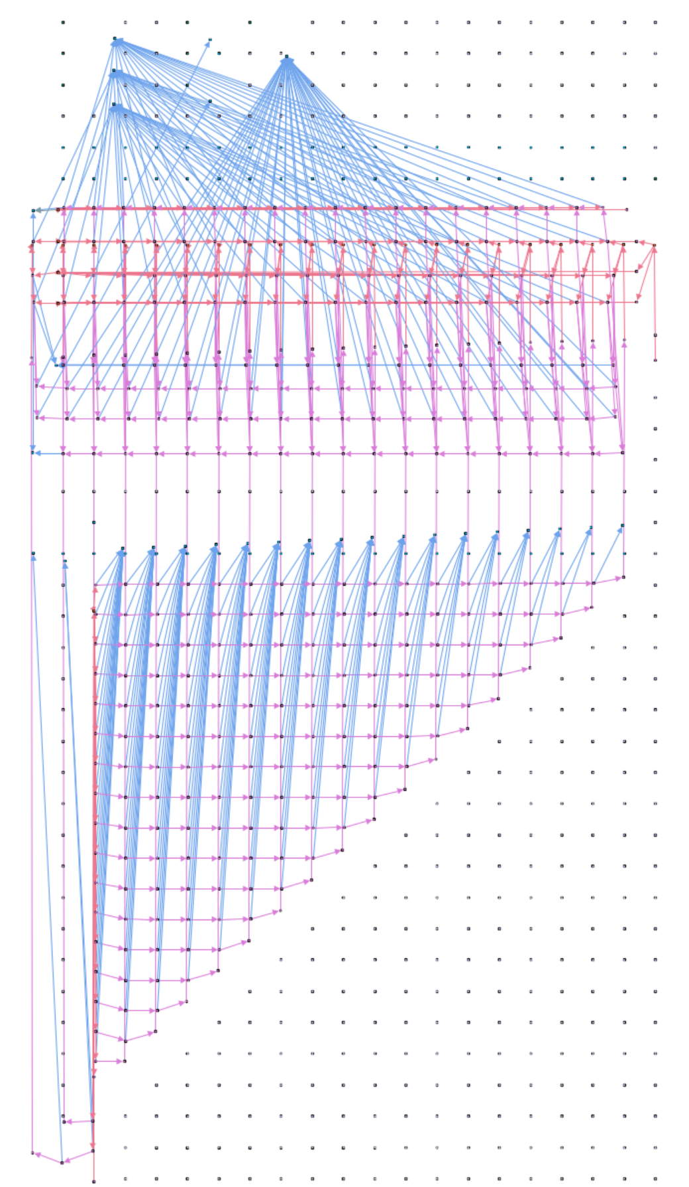

Slide 19
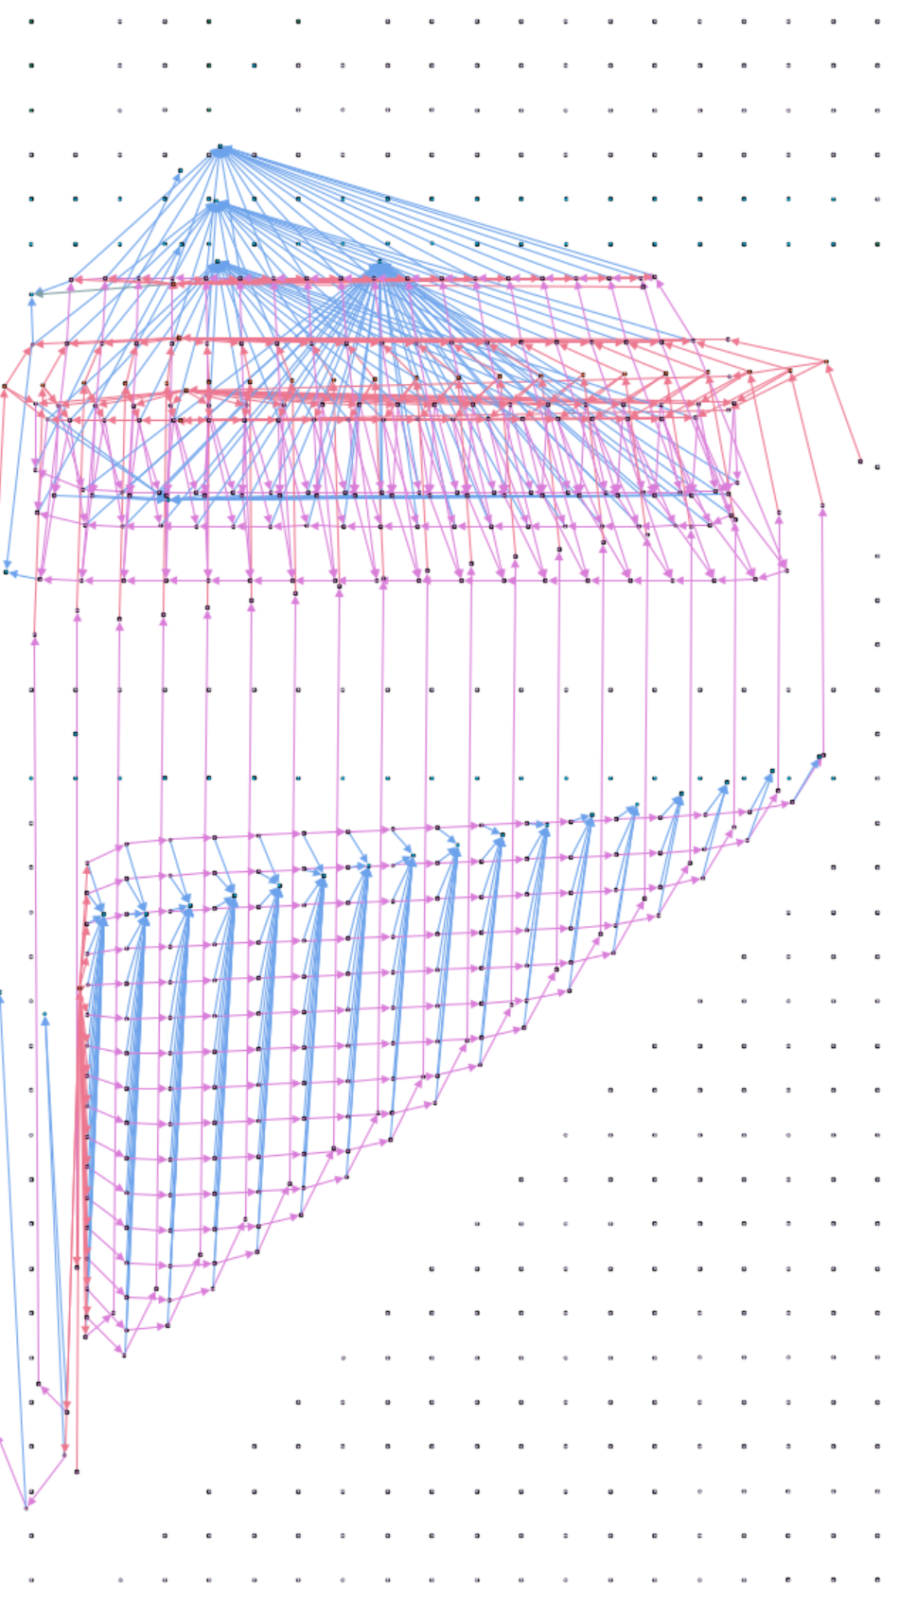

Slide 20
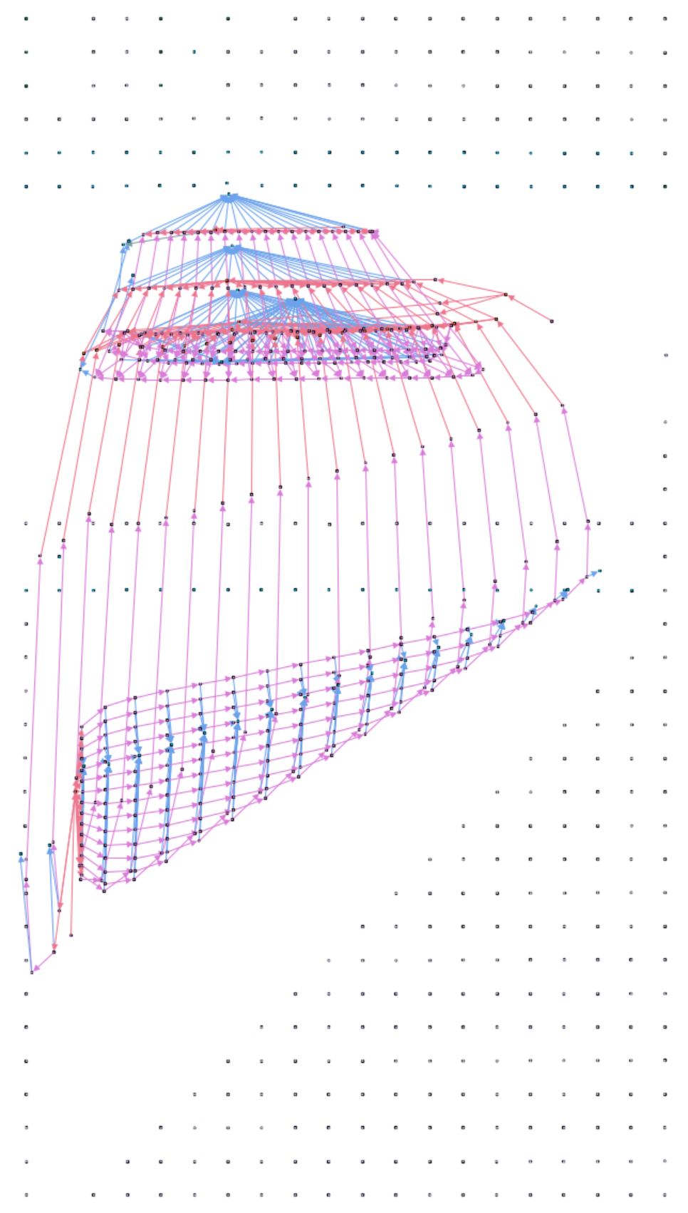

Slide 21
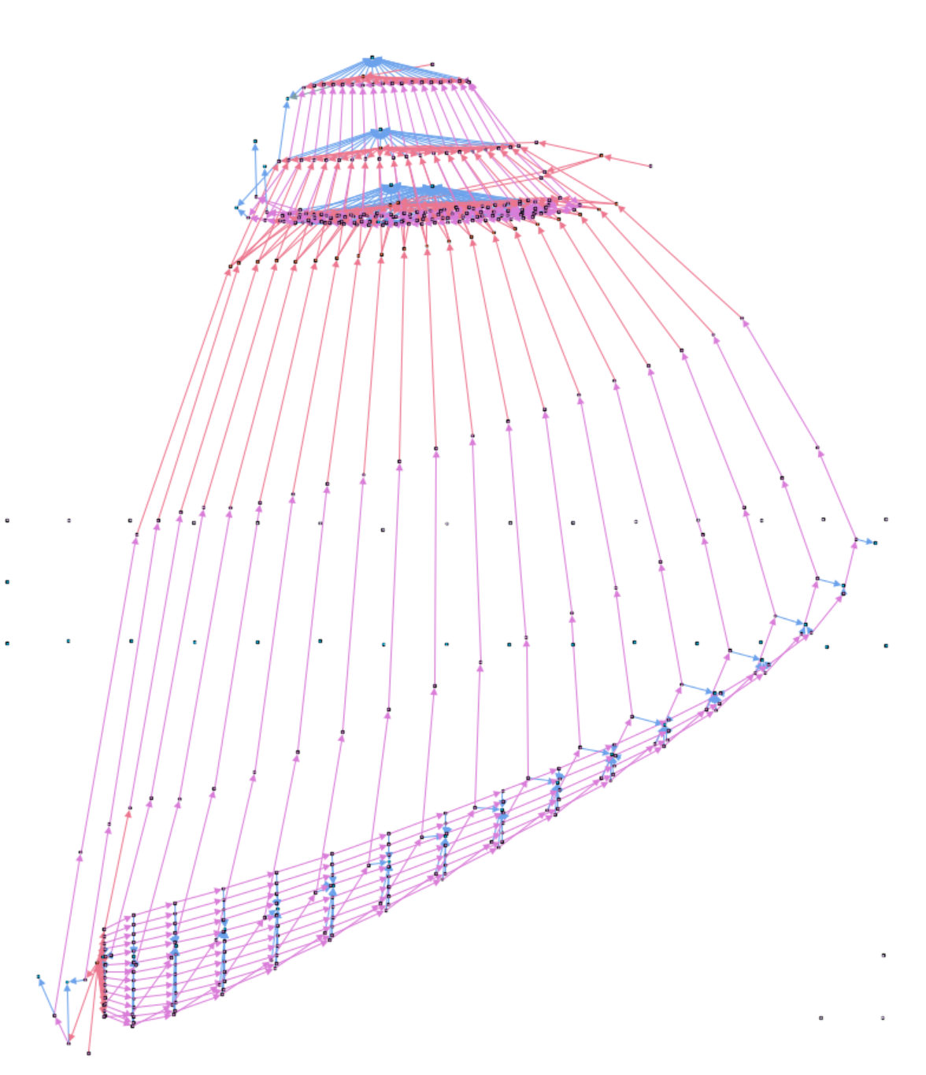

Slide 22
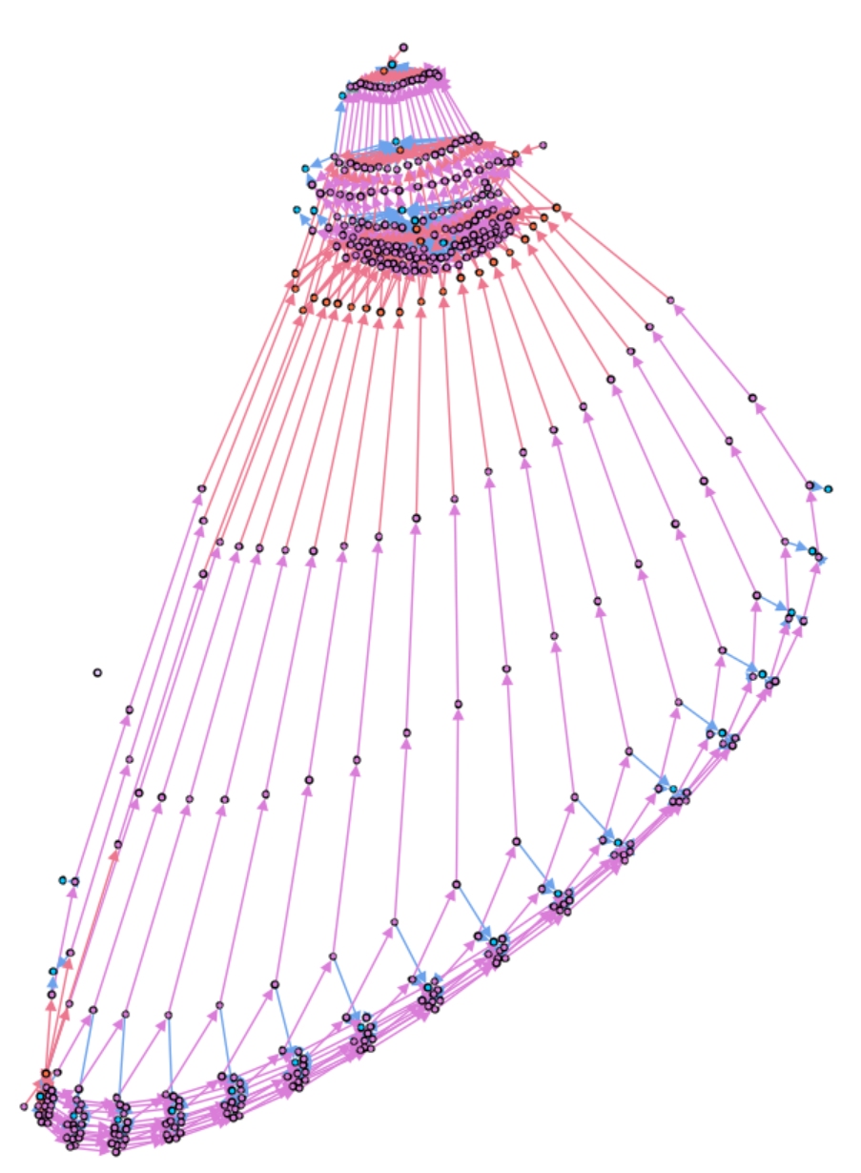

Slide 23
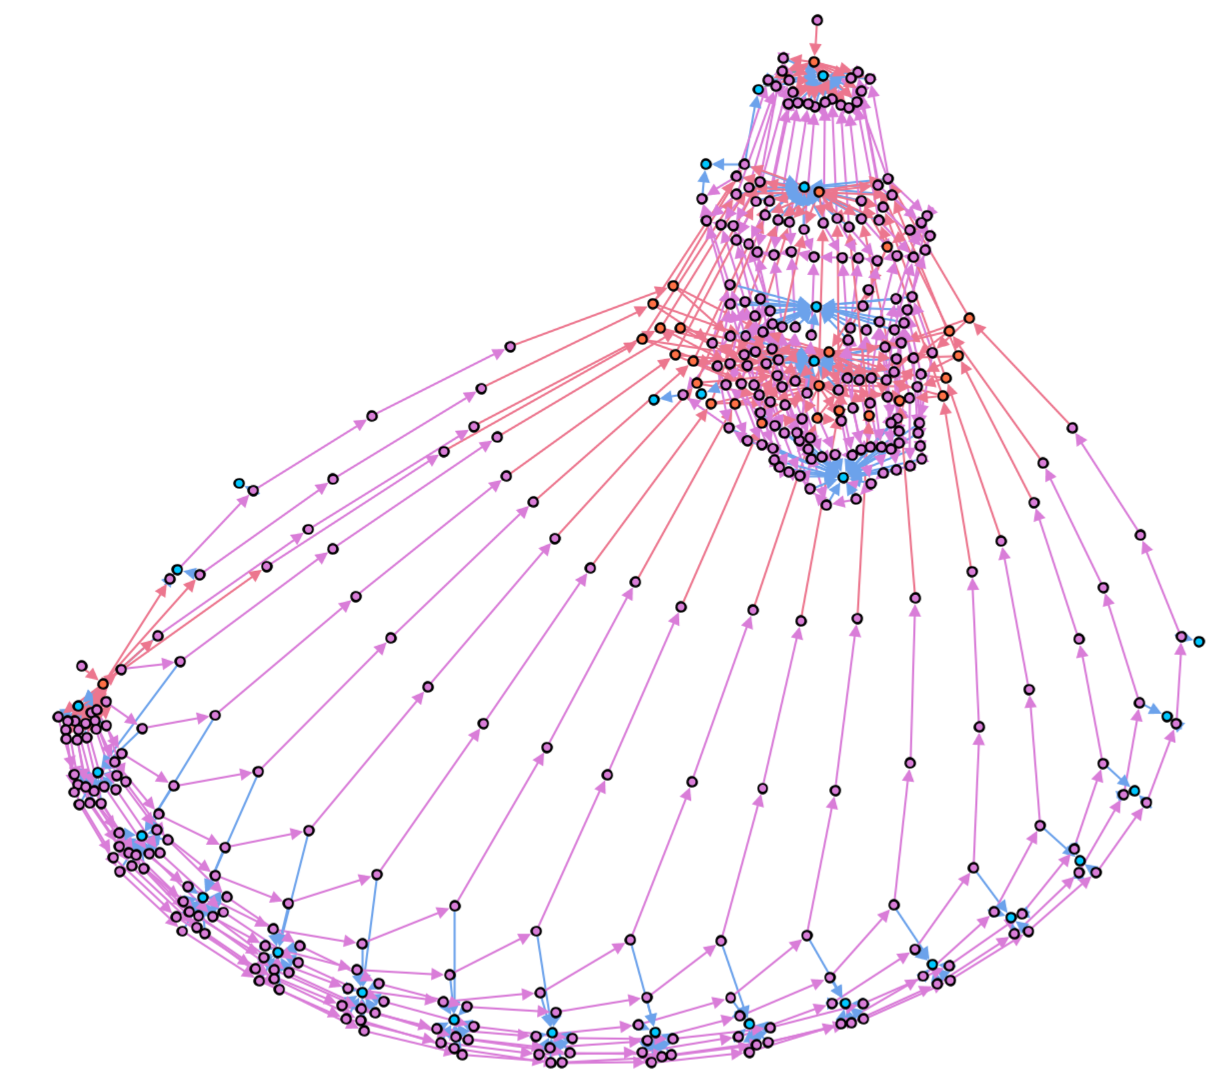

Slide 25
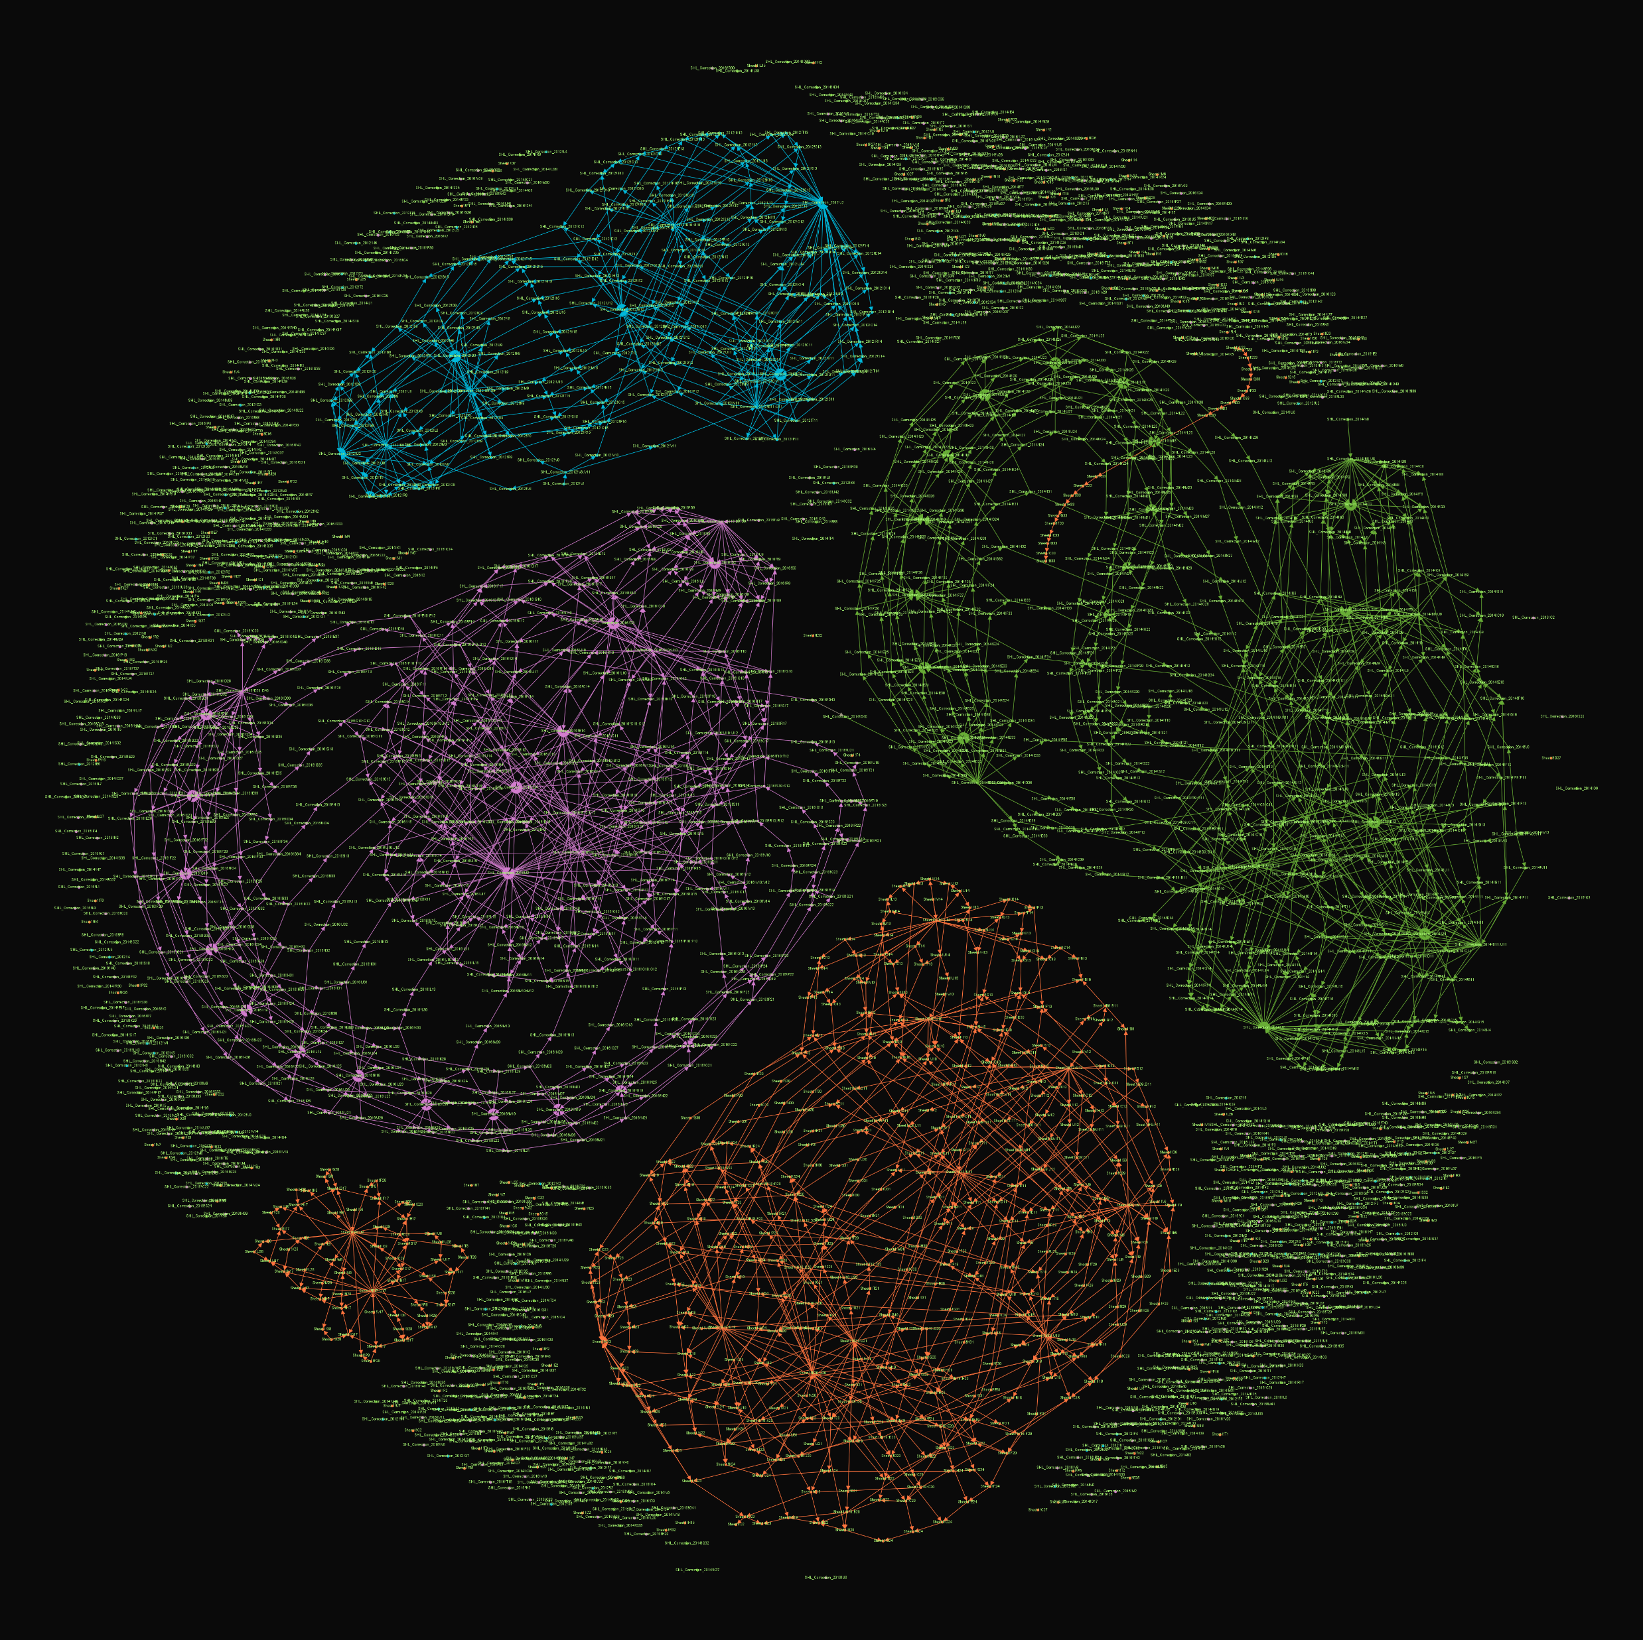
Cells on a Petri dish

Slide 26
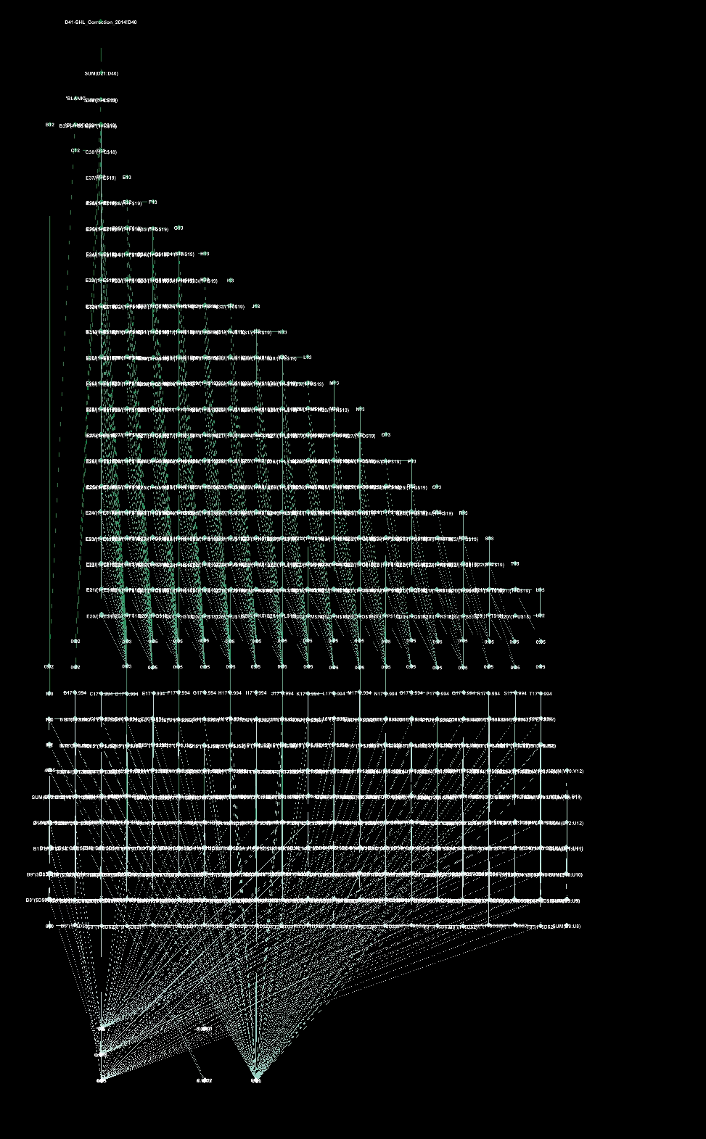
Or we can line them up >MSGFA2 algo

Slide 27
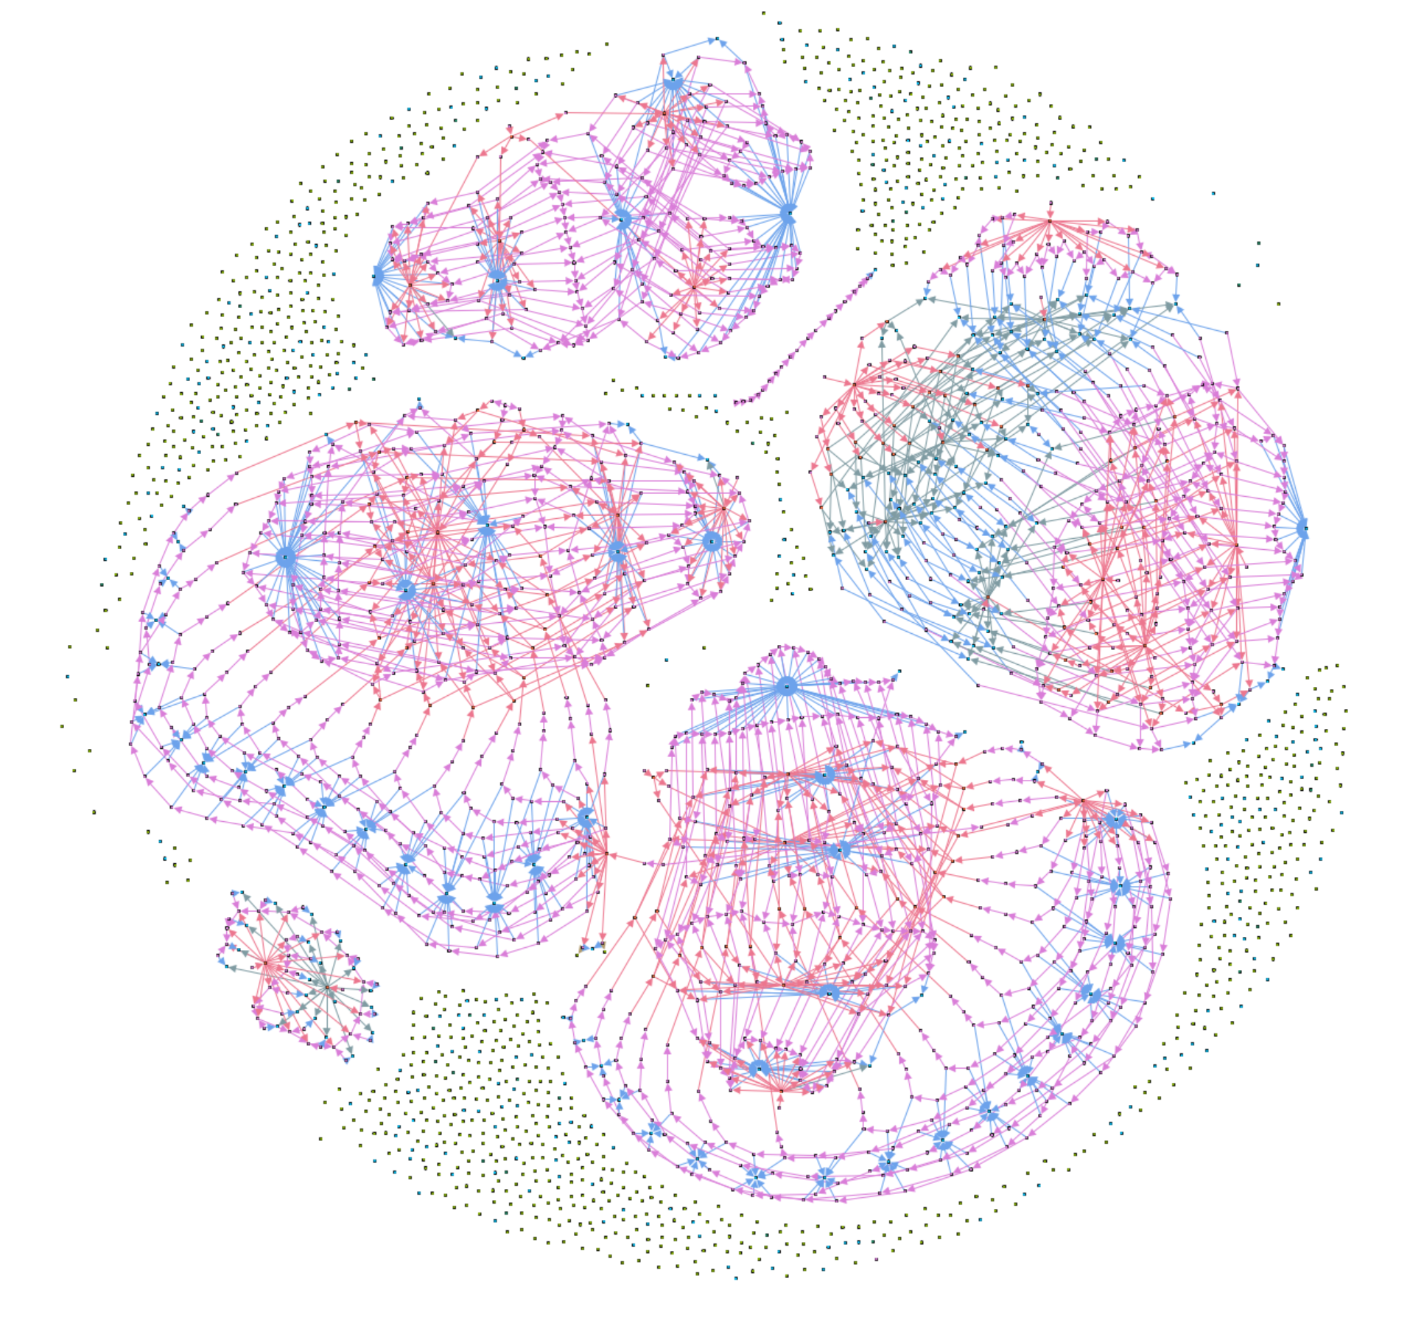
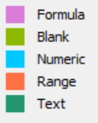
A dragged out chain of cells of the form A2=A1*1.10 used to roll a percentage increase over time.
A shared and commonly used numeric assumption in the model.
A triangular structure of cells calculating net present value of future profit. Each year along the arrow is further into the future and must be projected back one year further, giving the growing complexity of the calculation.
A comparison between two business cases. Note the two structurally identical calculation chains being compared differ only by different numeric business assumptions.
Examples of the business assumptions being frequently referenced in the calculation model.
A
B
E
D
C

Slide 28
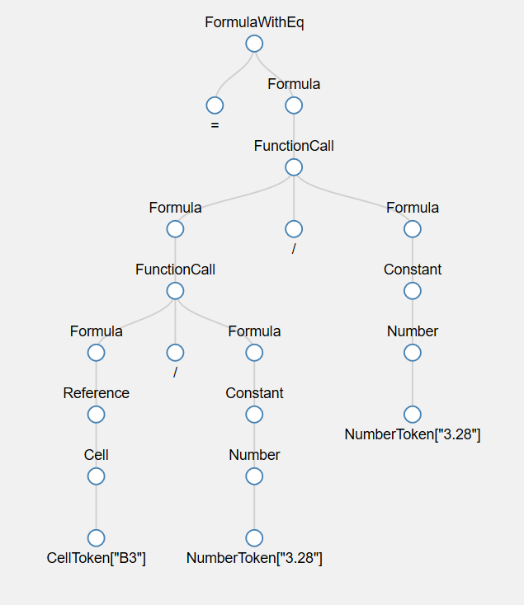
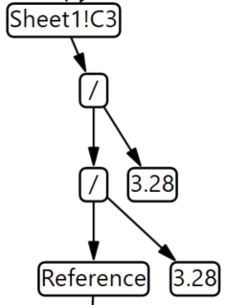
But all we are doing is playing with the prison cells – what is inside?
Refactoring | Purpose / Effect
RemoveReferenceNodes- BeforeFunctionCalls | Ensure that reference nodes appear only before cell references
RemoveFormulaEqNode | Remove the root node for formula trees so that the cell node may be used instead
InlineFunctionNames | Make the function name the root of the subtree
RemoveConstantNodes | Remove type indicator for constant nodes.
RemoveFormulaNodes | Make the function name the root of the subtree
RemoveNumberNodes | Remove type indicator for constant nodes.
RemoveArgumentNodes | Make the arguments of a node its direct children.
TruncateReferences | Truncate reference signatures for later processing.
=B3/3.28/3.28
Aivaloglou, E., Hoepelman, D. and Hermans, F., 2015, September. A grammar for spreadsheet formulas evaluated on two large datasets. In 2015 IEEE 15th International Working Conference on Source Code Analysis and Manipulation (SCAM) (pp. 121-130). IEEE.

Slide 29
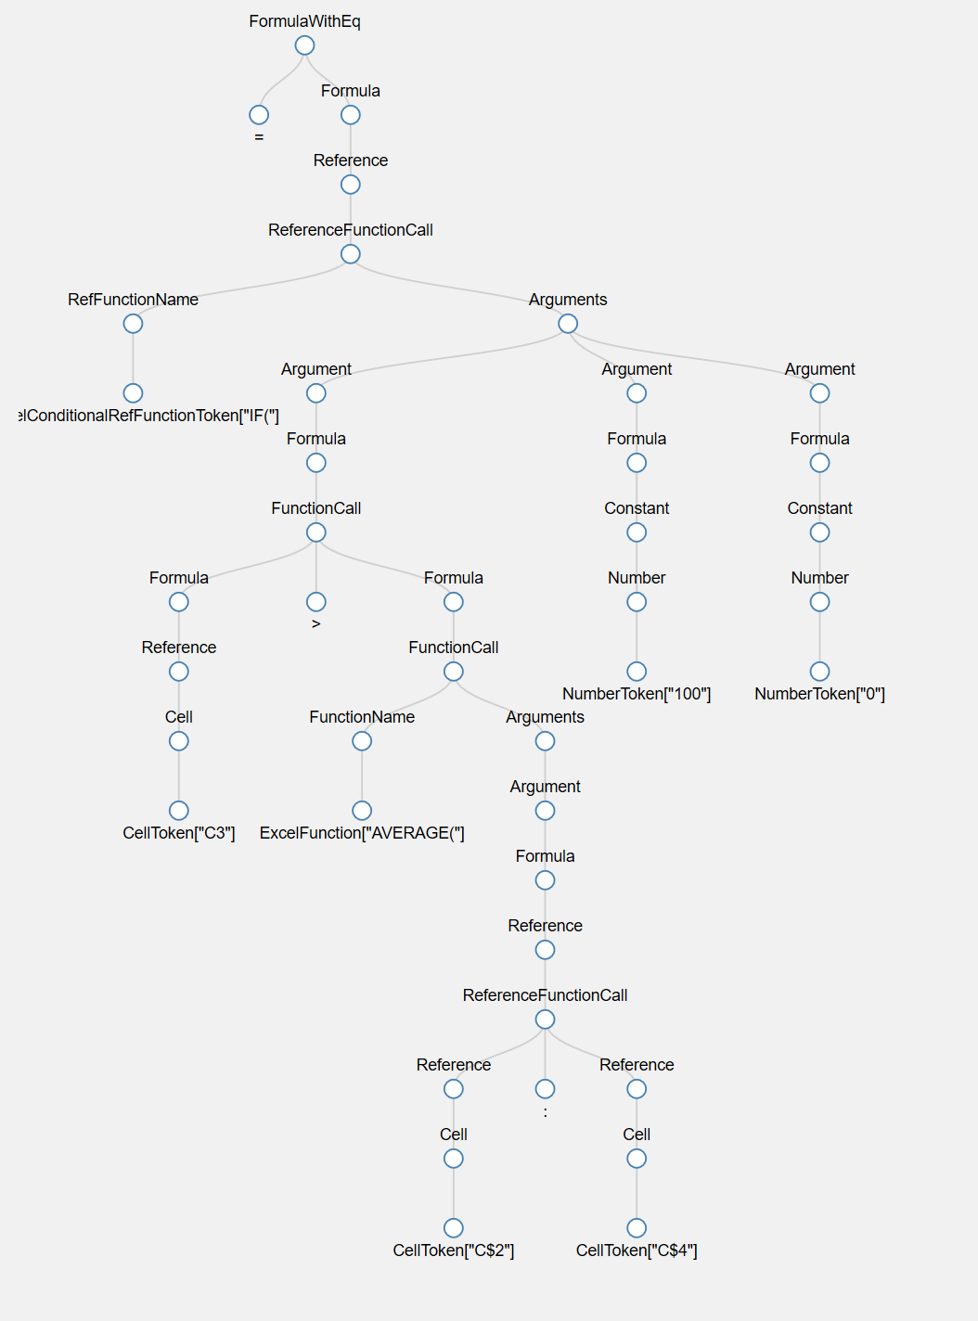
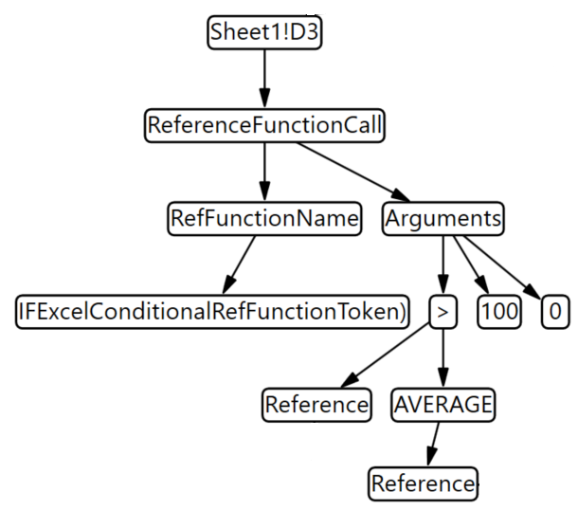
A more complex example
=IF(C3>AVERAGE(C$2:C$4),100,0)
Refactoring | Purpose / Effect
RemoveReferenceNodes- BeforeFunctionCalls | Ensure that reference nodes appear only before cell references
RemoveFormulaEqNode | Remove the root node for formula trees so that the cell node may be used instead
InlineFunctionNames | Make the function name the root of the subtree
RemoveConstantNodes | Remove type indicator for constant nodes.
RemoveFormulaNodes | Make the function name the root of the subtree
RemoveNumberNodes | Remove type indicator for constant nodes.
RemoveArgumentNodes | Make the arguments of a node its direct children.
TruncateReferences | Truncate reference signatures for later processing.
Aivaloglou, E., Hoepelman, D. and Hermans, F., 2015, September. A grammar for spreadsheet formulas evaluated on two large datasets. In 2015 IEEE 15th International Working Conference on Source Code Analysis and Manipulation (SCAM) (pp. 121-130). IEEE.

Slide 30
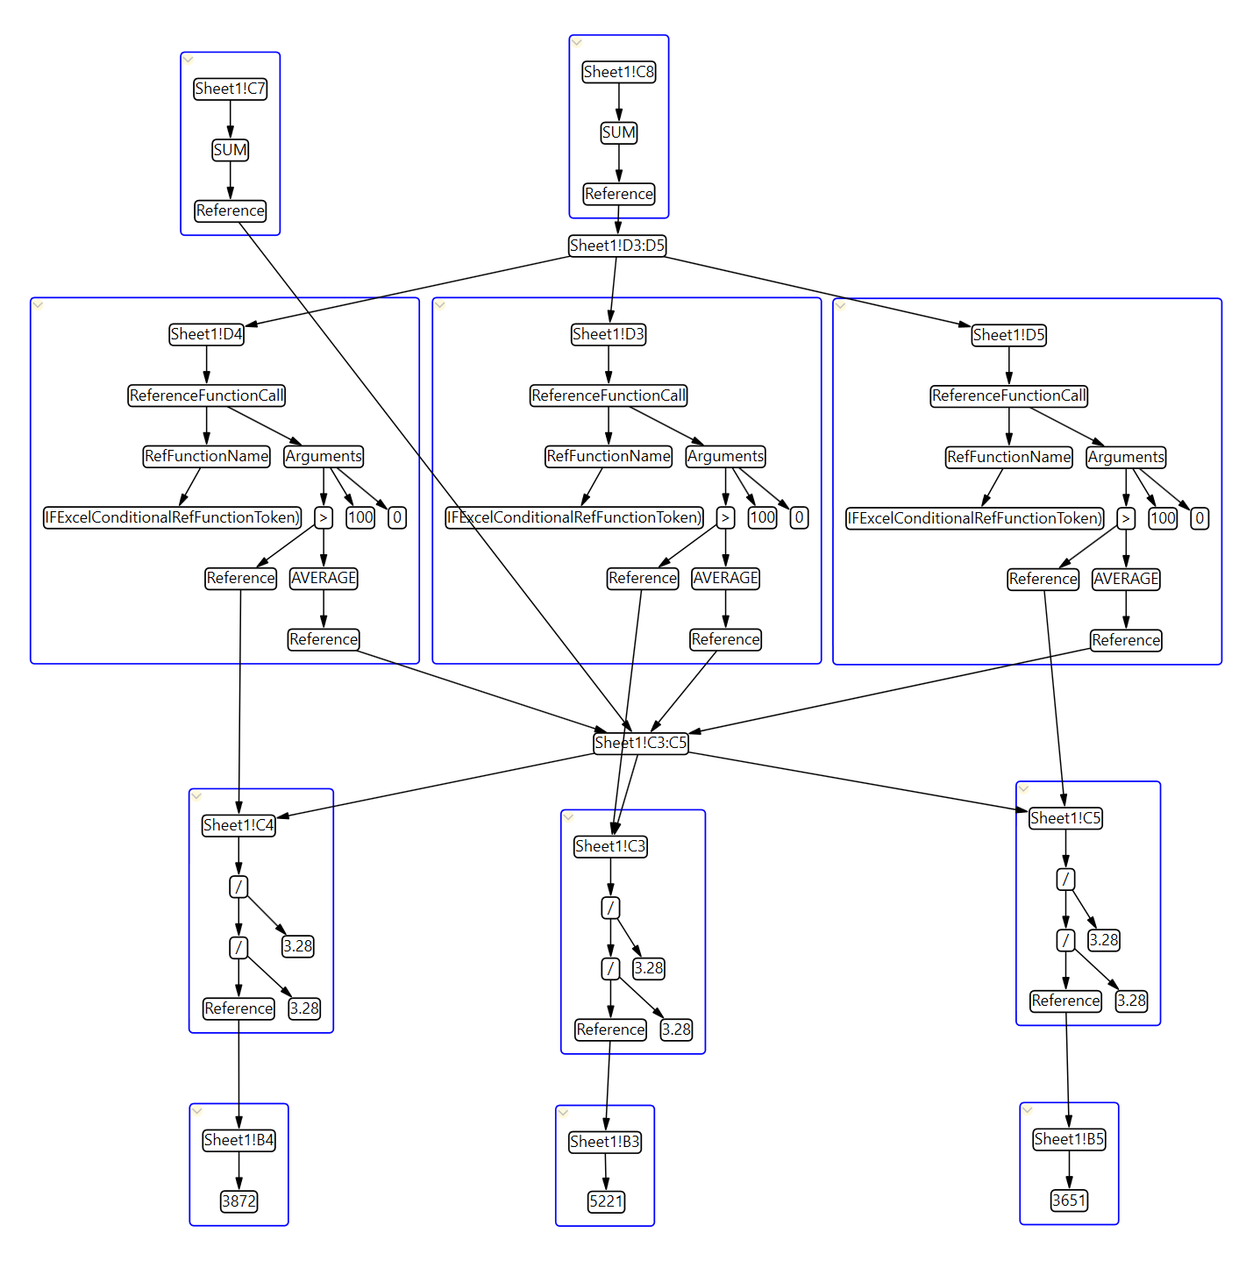
So what does a whole spreadsheet look like?
Abstraction Required

Slide 31
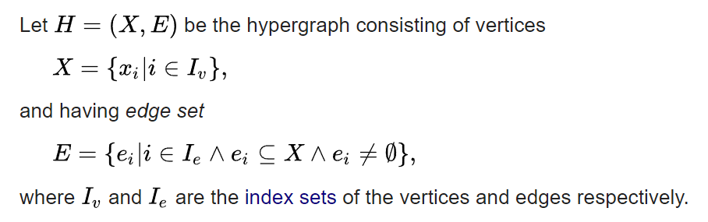
It’s a hypergraph

Slide 32
There are patterns here
Similar structures are repeated
Abstraction Required

Slide 33
There are patterns here
Similar structures are repeated

Slide 34
There are patterns here
Similar structures are repeated
Data Changes but calculation does not change
Vectorization!

Slide 35
Pattern matching AKA Graph Isomorphisms
By analysing this hypergraph view of the spreadsheet we seek mechanisms for abstracting the spreadsheet by redrawing the boundaries of cells. To identify opportunities for this process we seek to find repeated structure within the graph which may be replaced by a higher level more abstract “cell”. In order to do this we explore three abstracting operations:
We seek table structures of input values.
We seek vector (array) operations which apply the same operations to related data.
We seek common sub-expressions within cells which may be factored out to simplify the graph.

Slide 36
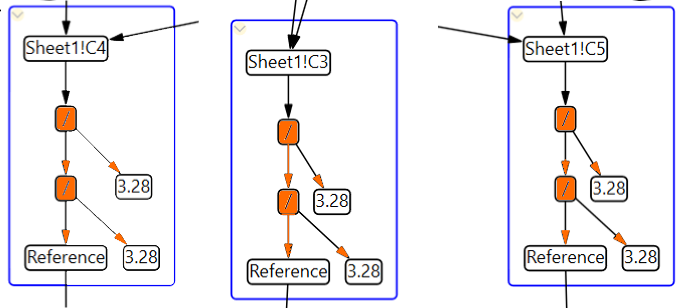
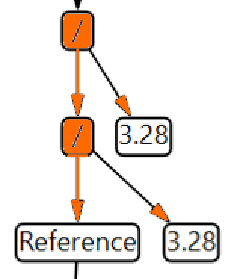
Pattern matching AKA Graph Isomorphisms
We seek common sub-expressions within cells which may be factored out to simplify the graph.
We seek vector (array) operations which apply the same operations to related data.
We seek table structures of input values.

Slide 37
Step by step
Structural isomorphism – the same operators in the same order
Colocation – located in a contiguous cell space
Constant isomorphism – using the same textual and numeric constants in its calculation
Reference isomorphism – using isomorphic references within its calculation.
Higher Level Abstraction
Compression of spreadsheets

Slide 38
Simplify the hyper graph
Find repeated graph structure
Redraw the cell walls
More abstract model
Each “cell” now operates on array data

Slide 39
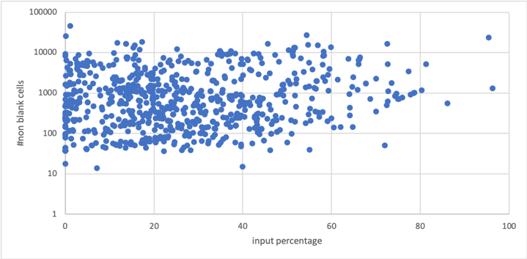
Results on Enron Sample (2124)

Slide 40
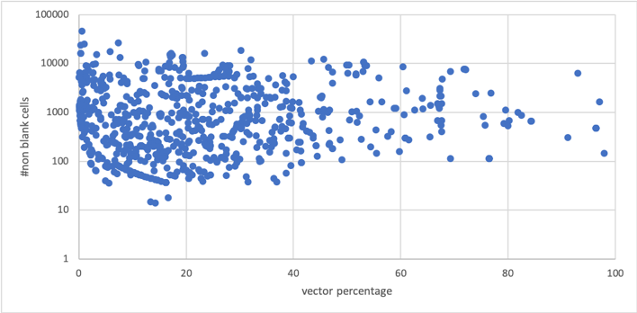
Results on Enron Sample (2124)

Slide 41
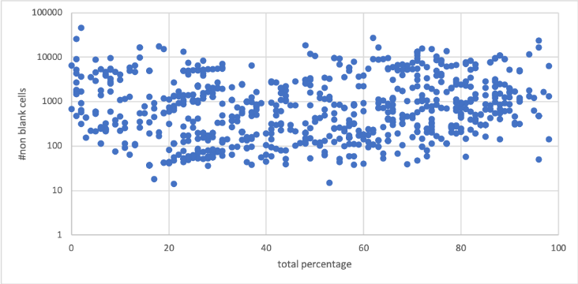
Results on Enron Sample (2124)

Slide 42
In Summary:
Cells > Graph
Formula > Graph
Cells = hypergraph edges
Seek repeated structure
Redraw the “cell walls” to create abstraction

